Slide 1
Mass Storage

Slide 2
Overview
Mass storage enables the computational state retention to be persistent between power cycles of the machine.
The majority of storage systems utilize four main types of mass storage devices: hard disk drives, solid-state drives, magnetic tapes, and optical storage. Although they serve largely the same purpose, they substantially differ in the underlying physical phenomena used to implement data retention as well their operational characteristics and cost.

Slide 3
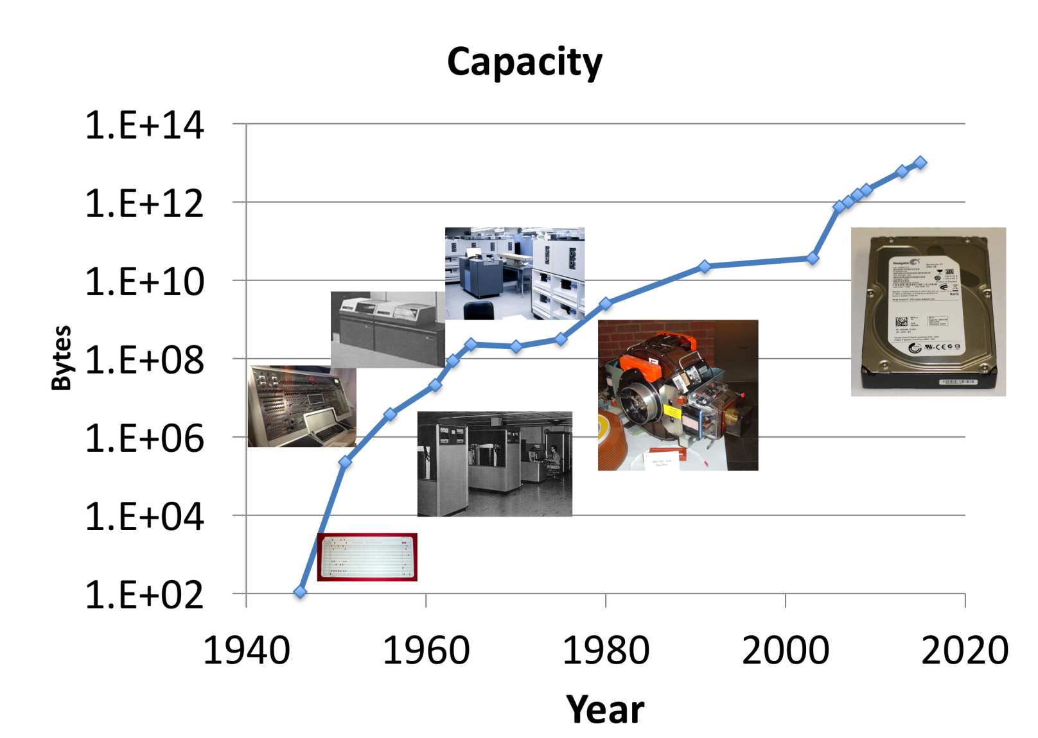
Brief History of Mass Storage

Slide 4
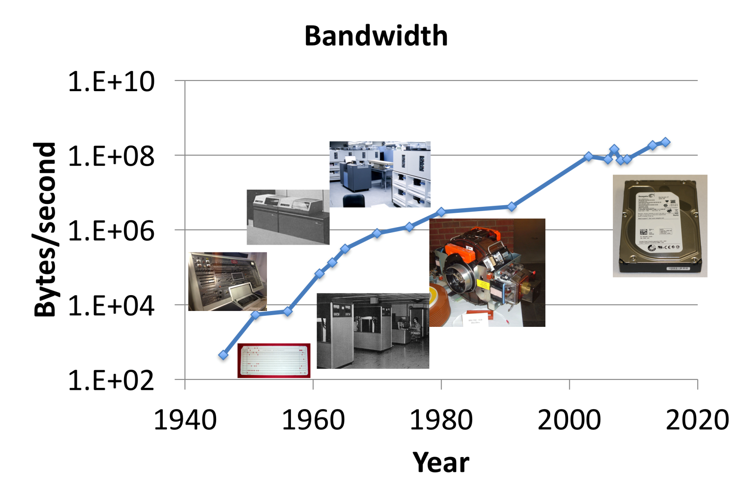
Brief History of Mass Storage

Slide 5
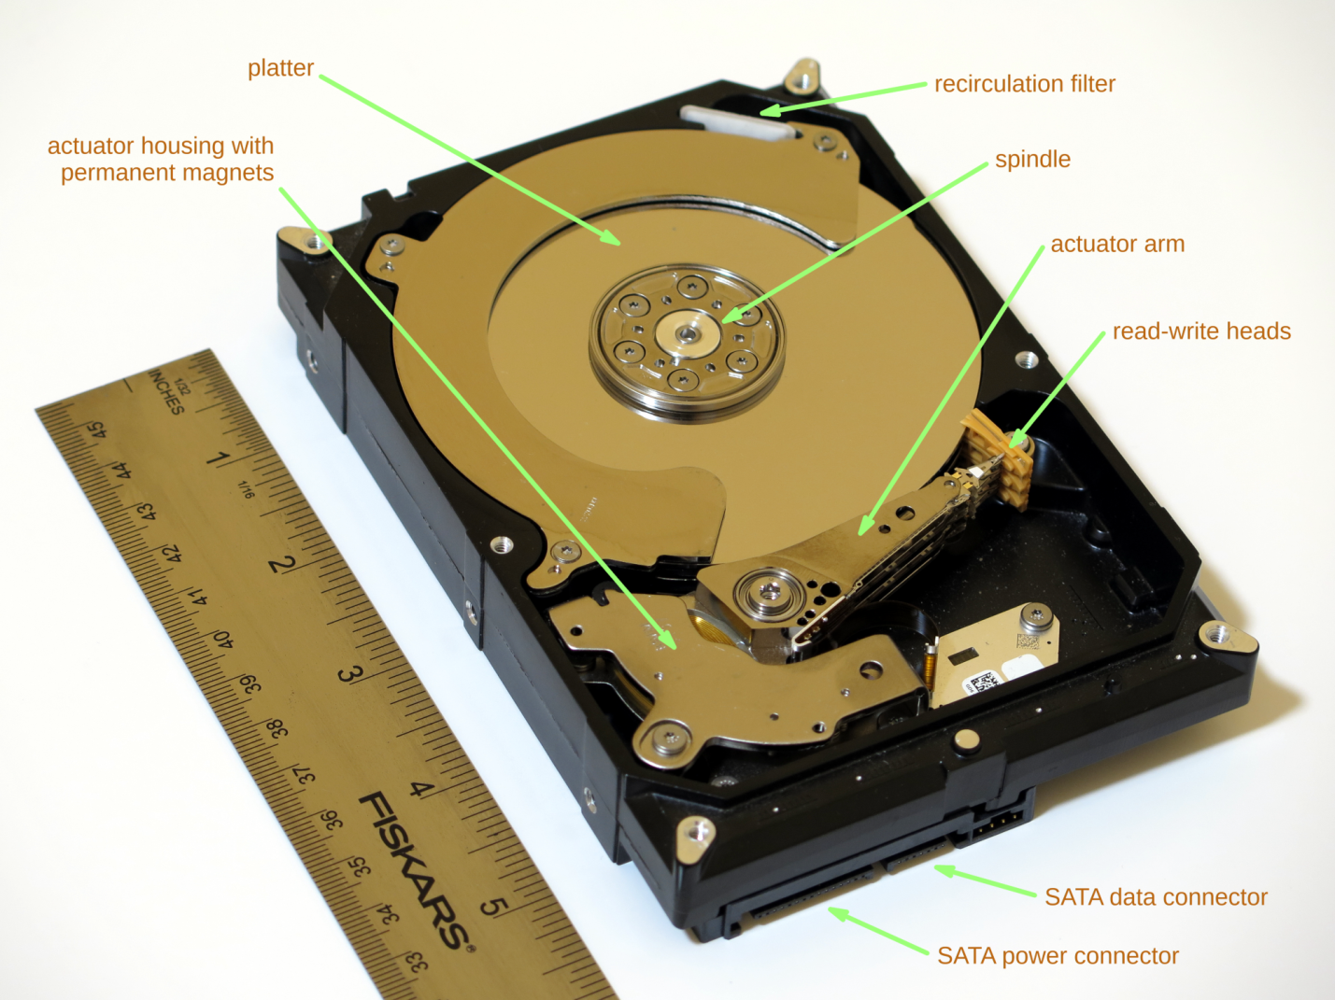
Internal components of a hard disk drive

Slide 6
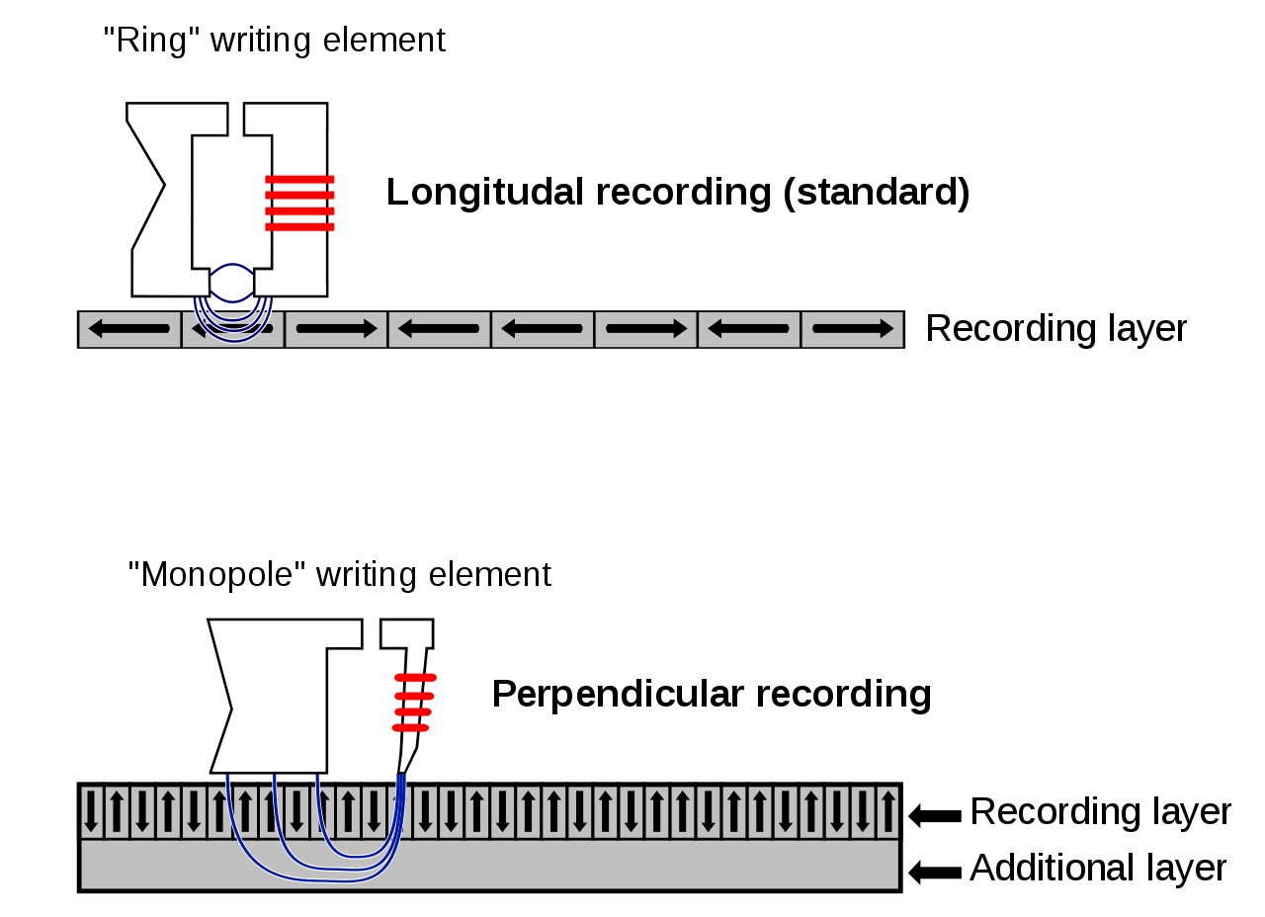
Bit density increase with perpendicular recording

Slide 7
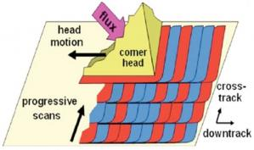
Sri Addition
Note: A new technology in drives is called “Shingled Magnetic Recording”
It’s basically like shingling a roof
And CATASTROPHIC for Raid/Zfs/Btrfs or any sort of enterprise or nas storage system.
Notes:
https://sata-io.org/developers/sata-ecosystem/shingled-magnetic-recording-boosting-capacity-and-lowering-costs
http://abdulmoeez55.blogspot.com/2015/12/shingled-magnetic-recording-smr.html

Slide 8
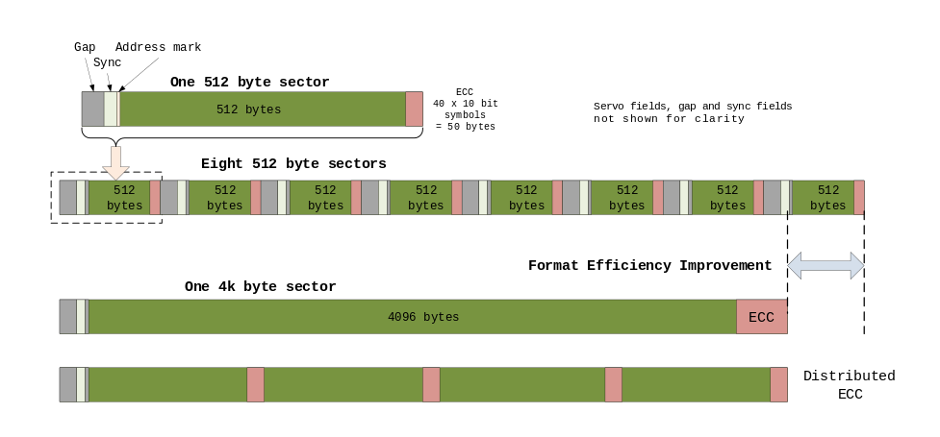
Physical information layout on HDDs: advantage of larger sectors

Slide 9
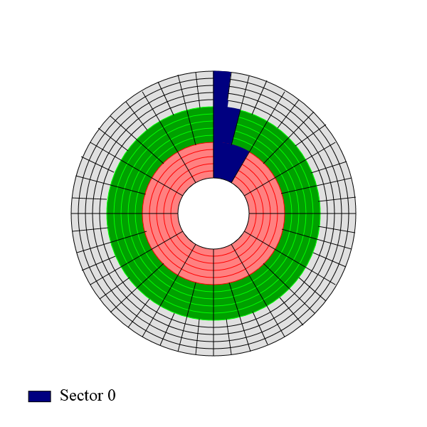
Physical information layout on HDDs: zone bit recording

Slide 10
Comparison of characteristic hard disk drive properties from several manufacturers
Manufacturer and drive | Capacity [TB] | Media transfer rate [MB/s] | Seek time [ms] |  | RPM | Cache (DRAM/flash) [MB] | MTBF [million hours] | Avg. power [W] |  | UER | Acoustic noise [dB(A)] |  | Form factor [inches] | Market segment
 |  |  | Track to track | Full stroke
 |  |  |  |  |  |  |  | Seek | Idle |  | Seek | Idle
WDC WD101KRYZ | 10 | 249 |  |  | 7200 | 256/0 | 2.5 | 7.1 | 5.0 | <1 in 10¹⁵ | 36 | 20 | 3.5 | Enterprise
WDC WD60EZRZ | 6 | 175 |  |  | 5400 | 64/0 |  | 5.3 | 3.4 | <1 in 10¹⁴ | 28 | 25 | 3.5 | Economy desktop
HGST HTS541010A9E680 | 1 | 124 | 1 | 20 | 5400 | 8/0 |  | 1.8 | 0.5 |  | 26 | 24 | 2.5 | Mobile
Seagate ST10000VX0004 | 10 | 210 |  |  |  | 256/0 | 1 | 6.8 | 4.42 | <1 in 10¹⁵ |  |  | 3.5 | A/V streaming
Seagate ST2000DX002 | 2 | 156 | <9.5 (average) |  |  | 64/8192 |  | 6.7 | 4.5 | <1 in 10¹⁴ |  |  | 3.5 | Performance desktop

Slide 11
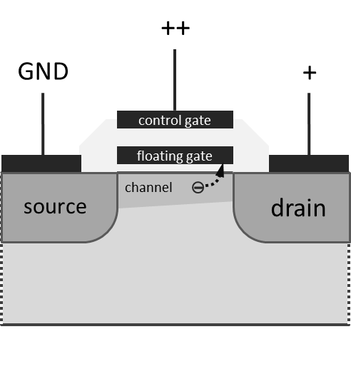
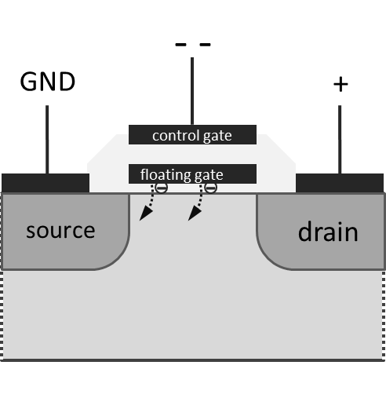
FGMOS Transistor
Programming by hot electron injection
Erase through quantum tunneling

Slide 12
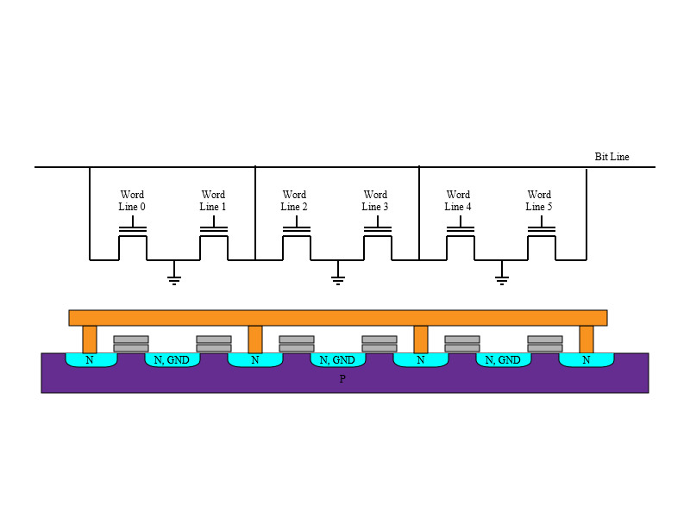
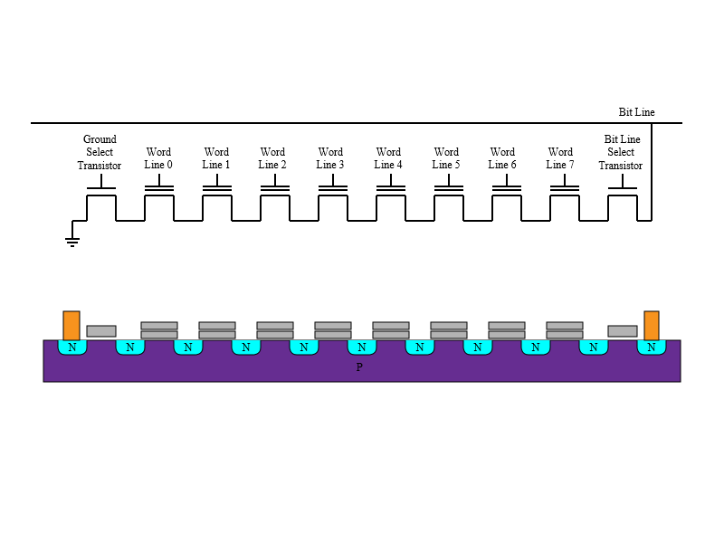
Storage cell connections and corresponding hardware implementation
NOR flash memory
NAND flash memory

Slide 13
Comparison of principal properties of NOR and NAND flash memory
Property | NOR flash | NAND flash
Capacity | Low | High
Cost per bit | High | Low
Read speed | High | Medium
Write speed | Very slow | Slow
Erase speed | Very slow (10s to 100s of ms) | Medium (single ms)
Erase cycles (endurance) | 100,000 – 1,000,000 | 1,000 – 10,000
Active power | High | Low
Standby power | Low | Medium
Random access | Easy | Hard
Block storage | Medium | Easy

Slide 14
Examples of currently manufactured SSD devices and their operational properties
Manufacturer and device | Capacity [GB] | Sequential read [MB/s] | Sequential write [MB/s] | Max. 4KB random reads [kIOPS] | Max. 4KB random writes [kIOPS] | Terabytes written | MTTF [million hours] | Power (active/idle) [W] | Memory type | Interface
Crucial CT2050MX300SSD1 | 2,050 | 530 | 510 | 92 | 83 | 400 | 1.5 | 0.15 (avg.) | 3D TLC NAND | SATA 6Gbps
Samsung MZ-V6P2T0BW | 2,048 | 3,500 | 2,100 | 440 | 360 | 1,200 |  | (5.8/1.2) | 48-layer MLC V-NAND | NVMe 1.1, PCIe 3.0 x4
SanDisk SDFADCMOS-6T40-SF1 | 6,400 | 2,800 | 2,200 | 285 | 385 | 22,000 |  | 25 (peak) | MLC | PCIe 2 x8

Slide 15
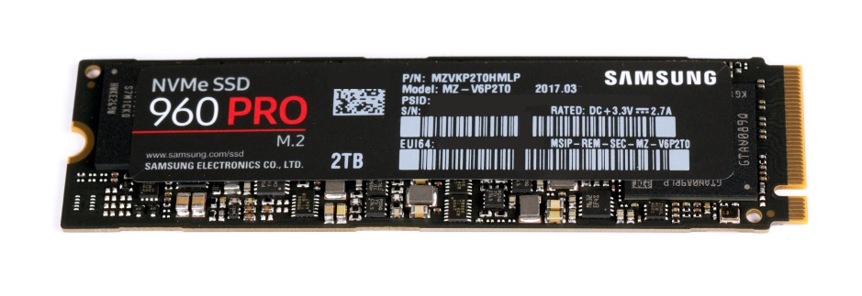
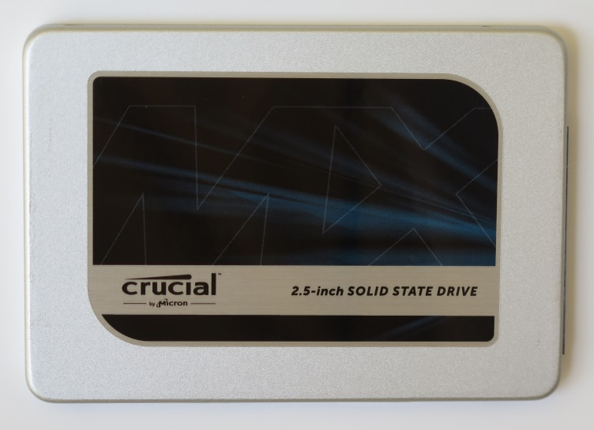
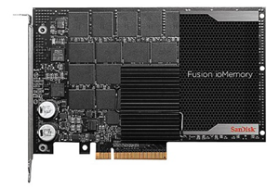
SSD Examples
Samsung 960 PRO series (M.2 form factor)
Crucial MX300 series (2.5” form factor)
SanDisk Fusion ioMemory SX350 series (8-lane, PCI-Express card)

Slide 16
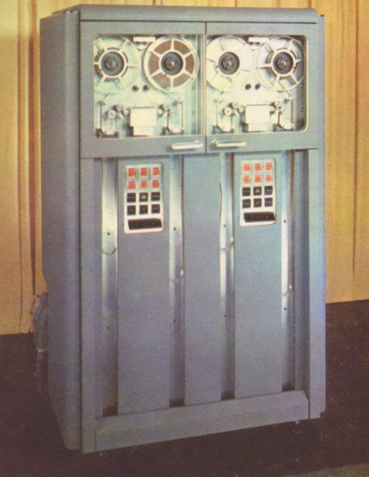
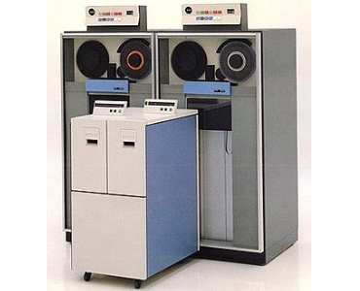
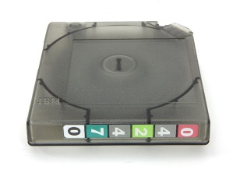
Advances in magnetic tape storage
IBM 726 from 1951
IBM 3480 format tape
IBM 3480 deck subsystem from 1984 with an older 3480 system in the background

Slide 17
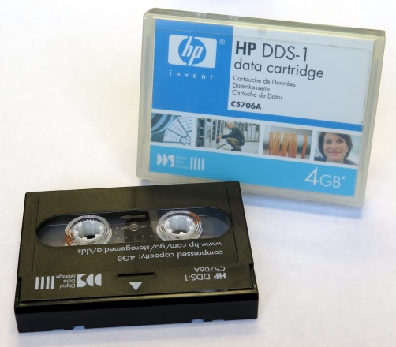
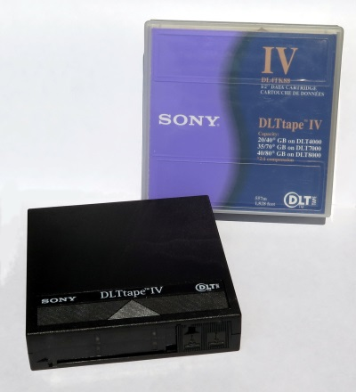
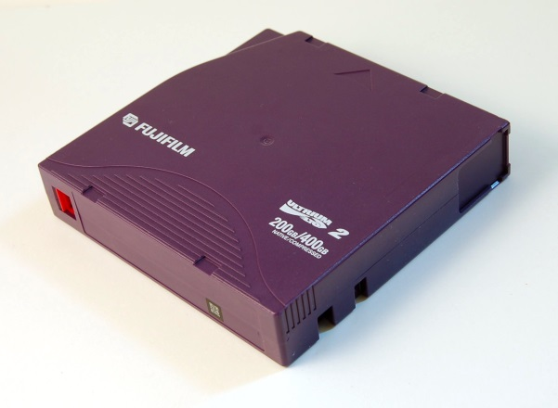
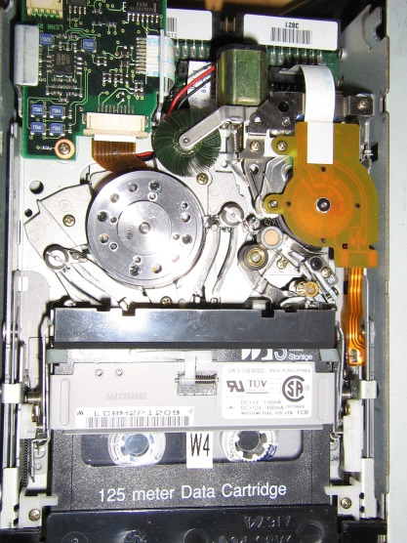
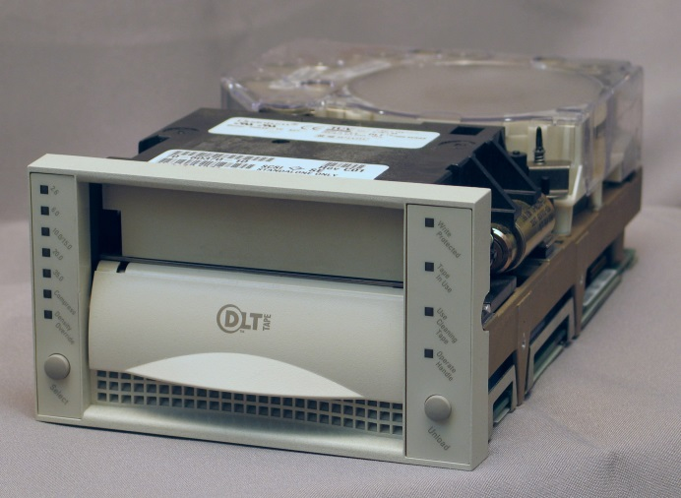
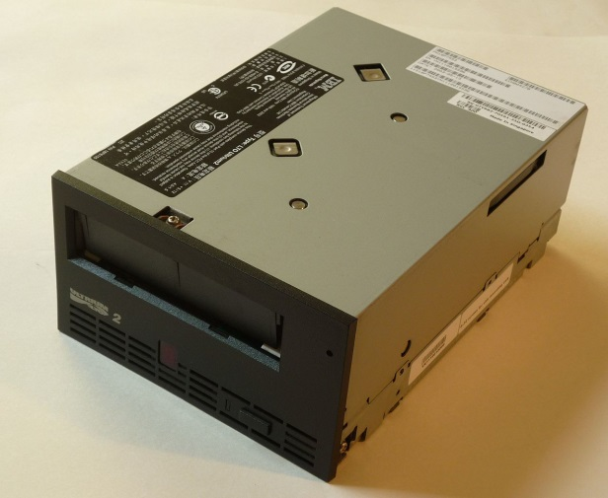
Comparison of dominant tape storage families
DDS-1 (1989)
DLT-IV (1999)
LTO-2 (2005)

Slide 18
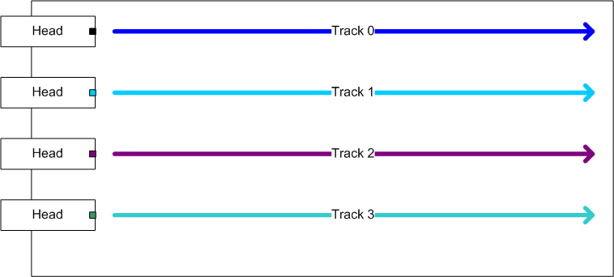
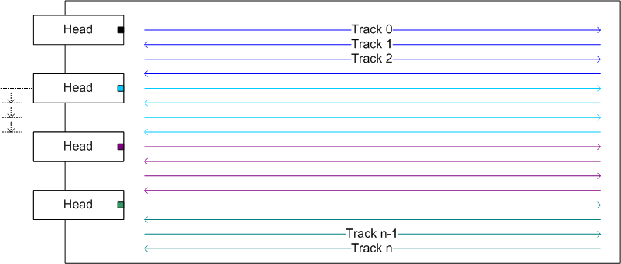
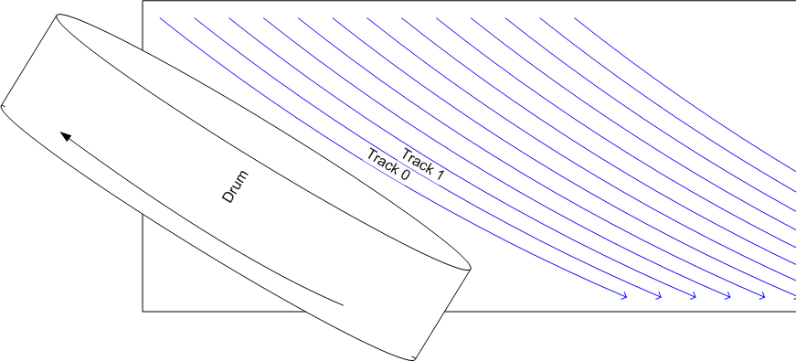
Tape recording formats
Linear
Linear-serpentine
Helical

Slide 19
Operational parameters of selected tape drives
Manufacturer and drive | Capacity [TB] | Sustained data rate [MB/s] | High-speed search [m/s] | Max. operating power [W] | Data format | Cartridge types supported | Interface
IBM TS1150 | Up to 10 (medium dependent) | 360, 300 | 12.4 | 46 | 32-channel linear-serpentine | IBM 3592 Gen. 3 and 4 | 8Gbps fibre channel
HP Enterprise BB873A | Up to 6 | 300 |  |  | 32-channel linear-serpentine | LTO-7 (RW), LTO-6 (RW), LTO-5 (RO) | 6Gbps SAS

Slide 20
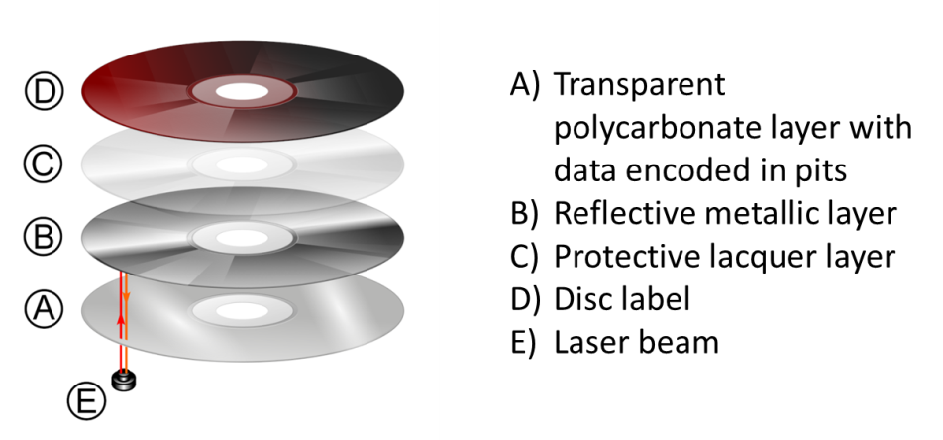

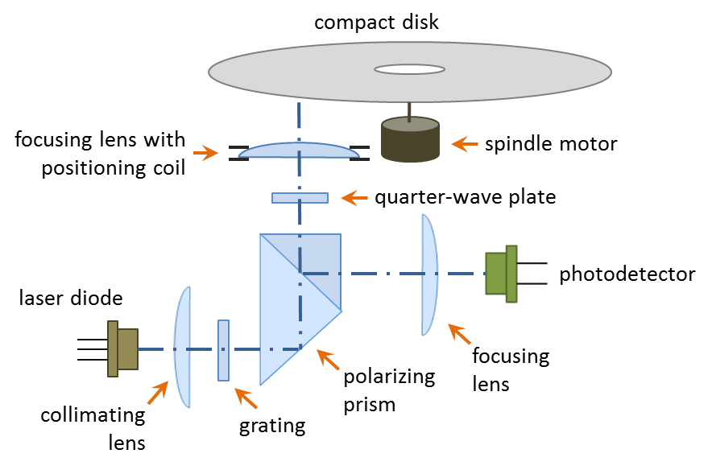
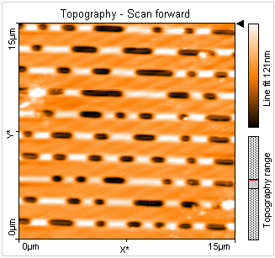
Optical Storage: Compact Disc
Medium
Component layers
Optical pickup mechanism
Geometric properties of the data track

Slide 21
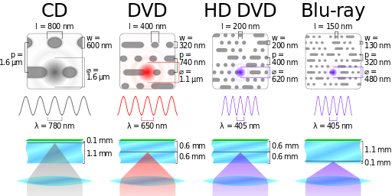
Comparison of optical format geometries (CD, DVD, HD-DVD, Blu-ray)
Listed parameters denote minimum feature length (l), track width (w), track pitch (p), laser beam diameter (φ), and wavelength (λ)

Slide 22
Parameters of a typical consumer-grade multi-format optical drive
Manufacturer and drive | BD access time [ms] | DVD access time [ms] | CD access time [ms] | Max. Data Rate |  |  |  |  |  | Buffer size [MB] | Interface
 |  |  |  | BD read | BD write | DVD read | DVD write | CD read | CD write
Lite-On iHBS312 | 250 (SL) 380 (DL) | 150 (ROM) 160 (DL) 200 (RAM) | 150 | 6× (RE DL) 8×(SL) | 2× (rewrite) 8× (DL) 12× (SL) | 16× | 6× (rewrite) 12× (RAM) 16× (+R, -R) | 48× | 24× (-RW) 48× (-R) | 8 | SATA (internal)

Slide 23
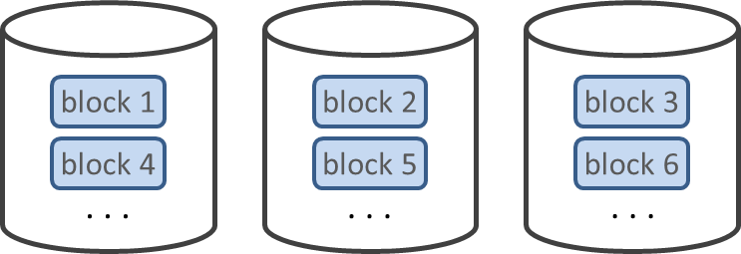
RAID 0: striping

Slide 24
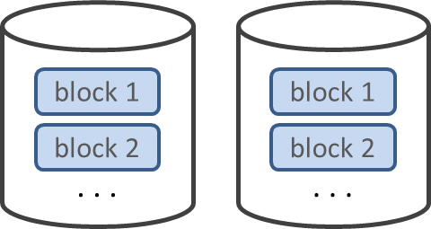
RAID 1: Mirroring

Slide 25
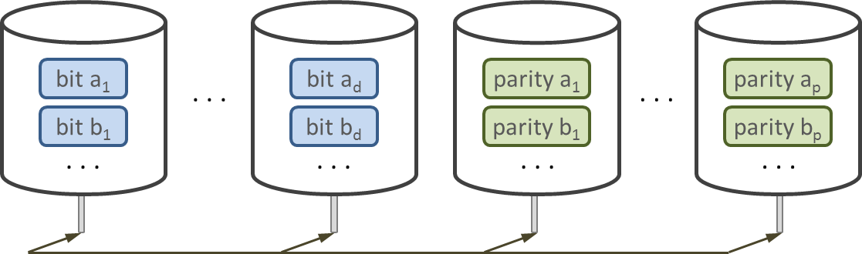
RAID 2: bit-level striping with Hamming code

Slide 26
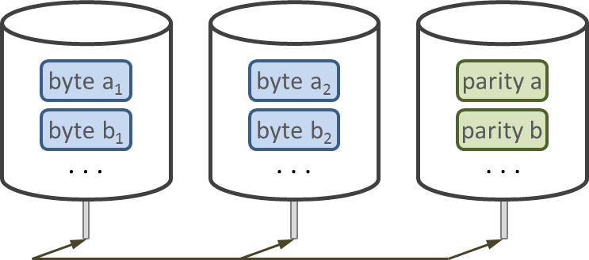
RAID 3: byte-level striping with dedicated parity

Slide 27
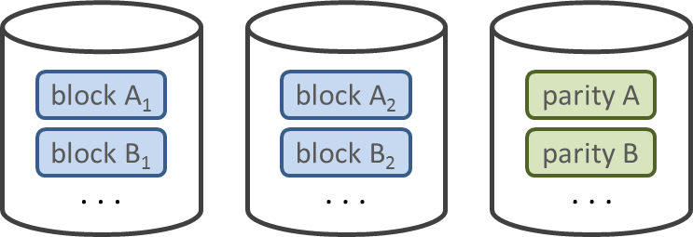
RAID 4: block-level striping with dedicated parity

Slide 28
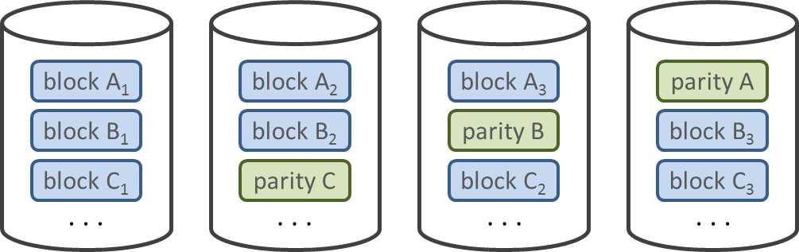
RAID 5: block-level striping with single distributed parity

Slide 29
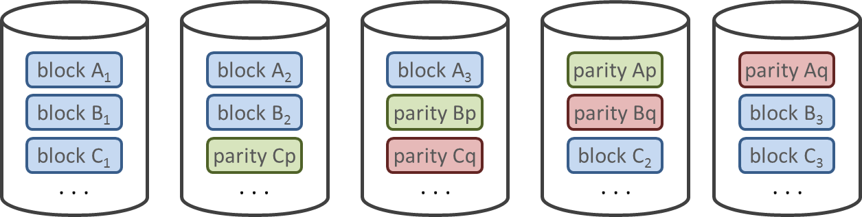
RAID 6: block-level striping with dual distributed parity

Slide 30
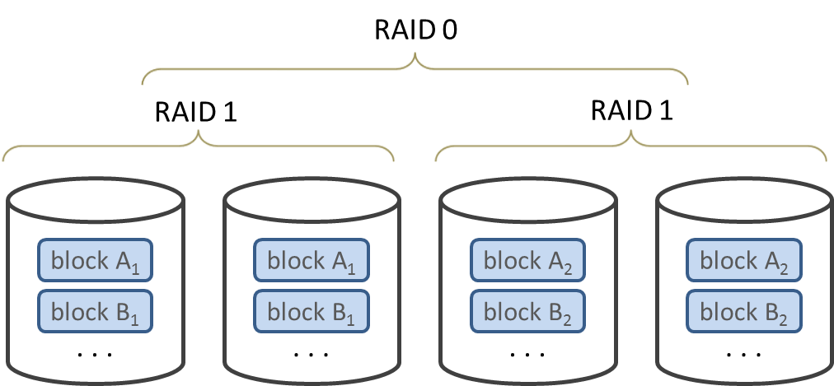
Hybrid RAID variants: RAID 10 (stripe of mirrors)

Slide 31

Hybrid RAID variants: RAID 01 (mirror of stripes)

Slide 32
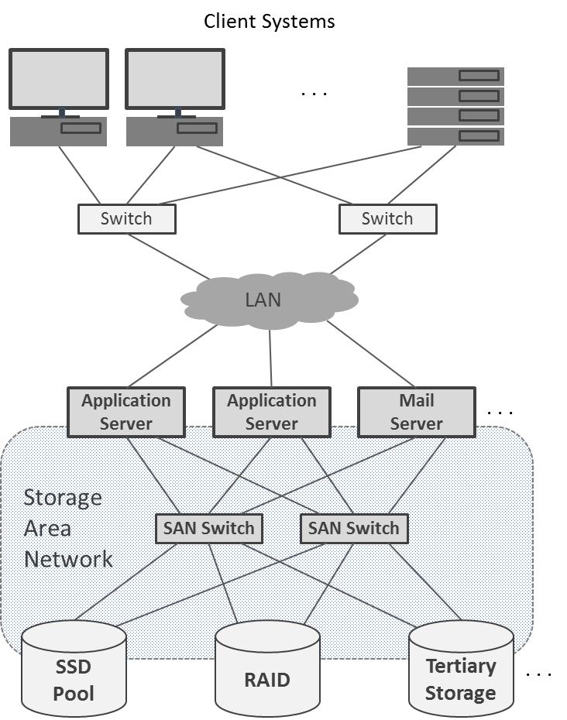
Example configuration of Storage Area Network

Slide 33
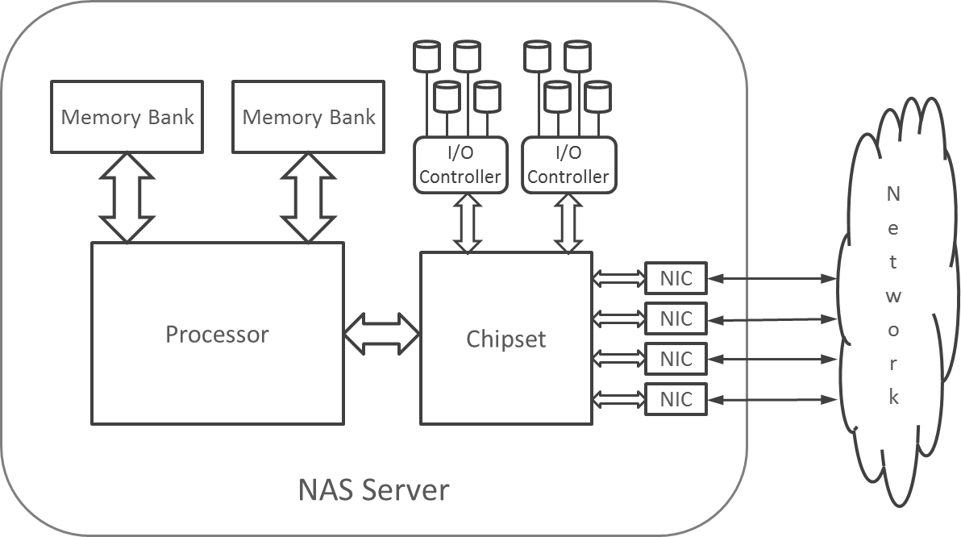
Simplified architecture of NAS server

Slide 34
Properties of selected high-capacity tertiary storage systems
Manufacturer | Product | Max. capacity [TB] | Media slots | Media type | Interface | Power
Quantum | Scalar i6000 tape library | 180,090 | 12,006 | LTO-7 cartridge | 8 Gbps Fibre Channel | 24 kVA
HIT Storage | HMS-5175 BluRay library | 175 | 1,750 | 100 GB BDTL disc | 1 Gbps Ethernet

Slide 35
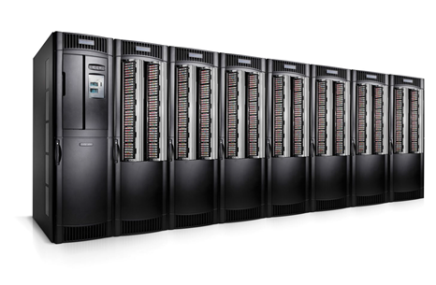
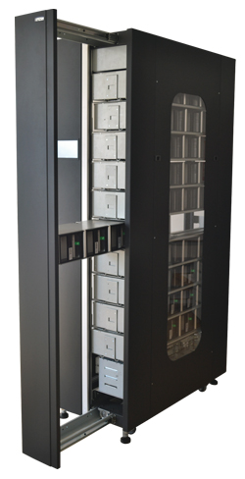
Tertiary storage platforms
Quantum tape library
BluRay optical jukebox

Slide 36
File Systems
WI 2023

Slide 37
Introduction
Large amounts of data need to be stored and managed in HPC systems
Different types of I/O devices
Different name space
Different interfaces
Providing uniform view of shared data in distributed environments
Coordination of concurrent and parallel accesses
Examples:
POSIX File API
Network File System (NFS)
General Parallel File System (GPFS)/Spectrum Scale
Lustre parallel file system

Slide 38
Abstracting Device Level Access
Storage devices are block devices
Data stored in physical blocks (a.k.a. sectors or records)
Access granularity ranges from 512 bytes to 16 KB
Low level access via physical addresses with potentially different translation algorithms for different devices
Performance considerations
Read vs. write (e.g., optical disks)
Access ordering (optimization of head movement)
In-memory caching support
Resilience considerations
Mitigation of media faults impact (“bad blocks”)
Reliability of multiple-device storage pools
Need for unified interface
Programmer’s productivity

Slide 39
File System Functions (I)
Storage and management of metadata (additional attributes associated with the actual data)
Ownership, Access Control Lists, time of creation/access/modification, setuid/setgid, “sticky bits”, extended attributes, …
Organization of data
Hierarchy of directories and files
Files contain data
Directories store files and other directories
Namespace implementation
Each directory and file has a name (not necessarily unique)
Individual components are identified by paths:
Paths originate in file system’s root
Contain all parent component names separated by a predefined character (e.g., “/”)
Paths uniquely identify each component (file or directory)
Other constructs: links, drive letters, …

Slide 40
File System Functions (II)
Storage space management
Physical space allocation
Maximization of performance for anticipated access patterns
Contiguous blocks within HDD tracks
Adjacent tracks to minimize HDD head movement latency
Load leveling (SSDs)
Session management with optical disks
File system mounting
Import of namespaces on other devices
Special file support
Sockets, named pipes, raw devices
Additional functionality available via fcntl and ioctl interfaces
Fault handling
Preserves data integrity
Sources of faults and inconsistencies
Media errors
Device errors
I/O interface errors
Power fluctuations
State replication (e.g., file buffer cache in memory)

Slide 41
Types of File Systems
Optimized for storage medium
HDDs (Extfs, Btrfs, ZFS, JFS, XFS, HFS+, VFAT, NTFS, …)
SSDs (ExtremeFFS, TrueFFS, also: kernel extensions of common HDD file systems)
Flash memories (JFFS2, F2FS, UBIFS)
Optical storage (ISO 9660, UDF)
RAM “disks” (ramfs, tmpfs, …)
ROM (CramFS, Romfs, SquashFS)
Distributed (AFS, NFS, )
Parallel (PVFS2, OrangeFS, GPFS, Lustre, PanFS, …)
Pseudo-file systems (procfs, sysfs, devfs, debugfs)
Many others

Slide 42
File System Features of Interest
Design limits
Maximum file size
Total number of files
Total number of directories
Total number of files per directory
Name and path length restrictions
In-memory caching of data and metadata
Write-back
Write-through
None
Integrity mechanisms
Journaling (metadata and/or block level)
Parity based mechanisms
Storage and performance optimizations
Log-structured (fast writes)
Copy-on-write
Extent support
Sparse file support
Variable block size
Tail merging
Execute-in-place
Volume resizing
Growing and shrinking
On- vs. off-line
Access rights
Unix-like
ACL
Capability based
Transparent data compression
Data de-duplication
Data encryption
Partition/volume-wide
Per file
Distributed operation
Distributed storage servers
Distributed client support
Concurrent access to shared data
Network type and protocol support
Availability for specific platform and OS

Slide 43
POSIX File Access Interface
“Portable Operating System Interface”
IEEE standard 1003.1 (originated in 1988)
File and directory API a part of specification
Two flavors
System call based
Higher overhead due to crossing into kernel space
Poor performance when many calls reading or writing small amounts of data are issued
Uses integer descriptors to identify open files
Streaming (buffered) I/O
Library based with OS backend
Transparent data buffers in application space used to limit the number of system calls
Uses pointer to FILE structure to describe an open file
More portable as a part of ISO/IEC C language standard
Function names typically begin with “f”
Both APIs maintain an implicit file offset (or “pointer”) specifying the location in file at which the operation is performed

Slide 44
File Open and Close
System calls
#include <sys/stat.h>
#include <fcntl.h>
int open(const char *path, int flags, …);
Opens a file in desired access mode returning its descriptor or -1 on error. flags include or-ed combination of O_RDONLY, O_WRONLY, O_RDWR, O_APPEND, O_CREAT, O_EXCL, O_TRUNC. The optional third argument specifies access mode if the file creation (O_CREAT) is requested.
#include <unistd.h>
int close(int fd);
Closes an opened file returning zero on success or -1 on error.
Streaming I/O
#include <stdio.h>
FILE *fopen(const char *restrict path, const char *restrict mode);
Opens a stream in accordance with mode parameter returning a pointer to FILE structure on success (or a NULL pointer otherwise). mode is either “r”, “w”, or “a” for read access, write access with initial truncation to zero length or append (write at the end of file), respectively. The mode character may be optionally followed by “+” to enable update mode (reading and writing in any order); for “a+” reading is initially performed at the start of the file while write appends to the end of the file.
int fclose(FILE *stream);
Closes stream returning zero on success or EOF is an error has occurred.

Slide 45
Data Read and Write
System calls
#include <unistd.h>
ssize_t read(int fd, void *buf, size_t n);
ssize_t write(int fd, void *buf, size_t n);
The read call copies n bytes from file identified by descriptor fd to buffer buf. The write call writes the contents of buf to a file identified by fd. Both return the number of bytes transferred or a negative number if an error occurred. The implicit file offset is updated by the number of bytes transferred.
Streaming I/O
#include <stdio.h>
size_t fread(void *restrict buf, size_t item, size_t count, FILE *restrict stream);
size_t fwrite(void *restrict buf, size_t item, size_t count, FILE *restrict stream);
The calls transfer an integral count of elements, each of size item bytes, between data buffer buf and stream. The calls return the actual number of items transferred. It may be less than count if the end of file was encountered or an error occurred. The internal file pointer is increased by the number of bytes copied.

Slide 46
File Offset Manipulation
System calls
#include <unistd.h>
off_t lseek(int fd, off_t offs, int whence);
lseek updates the internal file offset depending on the value of parameter whence:
SEEK_SET – the file offset is set to offs,
SEEK_CUR – the value of offs is added to file offset,
SEEK_END – the file offset is set to the sum of file size and offs.
File offset may be set to point beyond the original end of file; the unwritten portion of file will read as zeroes until explicitly overwritten. The call returns the updated offset value.
Streaming I/O
#include <stdio.h>
int fseek(FILE *stream, long offset, int whence);
long ftell(FILE *stream);
The fseek call sets the file offset for stream; the meaning of whence argument is the same as for lseek. It returns zero on success or -1 on error. ftell returns the current value of file offset or -1 on error.

Slide 47
Data Access with Explicit Offset
System calls
#include <unistd.h>
ssize_t pread(int fd, void *buf, size_t n, off_t offs);
ssize_t pwrite(int fd, void *buf, size_t n, off_t offs);
The calls have analogous semantics to read and write, except they are performed at the file offset specified by offs. The value of the internal file offset associated with fd is not modified.
Streaming I/O
No equivalent.

Slide 48
Data Buffer Flush
System calls
#include <unistd.h>
off_t fsync(int fd);
Transfers all data and metadata associated with fd to permanent storage. The call blocks until all buffered data are written (zero return value) or an error occurs (return value -1).
Streaming I/O
#include <stdio.h>
int fflush(FILE *stream);
Flushes all unwritten data associated with specific stream to the underlying OS file (but not necessarily to storage). If the stream was opened for reading, it updates the underlying file’s offset to match the current offset of stream. If stream is NULL, the buffers of all streams opened by the application are flushed. Returns zero on success or EOF on error.

Slide 49
File Status Query
System calls
#include <fcntl.h>
#include <sys/stat.h>
int lstat(const char *restrict path, struct stat *restrict buf);
int fstat(int fd, struct stat *restrict buf);
The calls retrieve metadata of a file identified by path (lstat) or the opened descriptor (fstat) and place them in buffer buf. The stat structure stores, among others, size of file in bytes (st_size), access mode (st_mode), owner’s user ID (st_uid), owner’s group ID (st_gid), last access time (st_atim), last modification time (st_mtim), and last status change time (st_ctim). Both return zero if the call was successful or -1 on failure.
Streaming I/O
No equivalent.

Slide 50
File Descriptor and Stream Conversion
Open a stream associated with a file identified by fd:
#include <stdio.h>
FILE *fdopen(int fd, const char *mode);
The mode parameter must be compatible with the access type with which the underlying file was opened. “w” and “w+” modes do not truncate the file. File descriptor will be closed when the related stream is closed.
Retrieve descriptor of a file used by stream:
#include <unistd.h>
int fileno(FILE *stream);

Slide 51
Example: system calls
Example: streams
001 #include <stdio.h>
002 #include <stdlib.h>
003 #include <unistd.h>
004 #include <sys/stat.h>
005 #include <fcntl.h>
006
007 #define BUFFER_SIZE 4096
008 #define HALF (BUFFER_SIZE/2)
009
010 int main(int argc, char **argv)
011 {
012 // initialize buffer
013 int wbuf[BUFFER_SIZE], i;
014 for (i = 0; i < BUFFER_SIZE; i++) wbuf[i] = 2*i+1;
015
016 // open file, write buffer contents, and flush it to the storage
017 int fd = open("test_file.dat", O_WRONLY|O_CREAT|O_TRUNC, 0600);
018 int bytes = BUFFER_SIZE*sizeof(int);
019 if (write(fd, wbuf, bytes) != bytes) {
020 fprintf(stderr, "Error: truncated write, exiting!\n");
021 exit(1);
022 }
023 fsync(fd);
024 close(fd);
025
026 // retrieve the second half of the file and verify
027 int rbuf[HALF];
028 fd = open("test_file.dat", O_RDONLY);
029 bytes /= 2;
030 if (pread(fd, rbuf, bytes, bytes) != bytes) {
031 fprintf(stderr, "Error: truncated read, exiting!\n");
032 exit(1);
033 }
034 close(fd);
035
036 for (i = 0; i < HALF; i++)
037 if (wbuf[i+HALF] != rbuf[i]) {
038 fprintf(stderr, "Error: retrieved data is invalid!\n");
039 exit(2);
040 }
041 printf("Data verified.\n");
042
043 return 0;
044 }
001 #include <stdio.h>
002 #include <stdlib.h>
003 #include <unistd.h>
004
005 #define BUFFER_SIZE 4096
006 #define HALF (BUFFER_SIZE/2)
007
008 int main(int argc, char **argv)
009 {
010 // initialize buffer
011 int wbuf[BUFFER_SIZE], i;
012 for (i = 0; i < BUFFER_SIZE; i++) wbuf[i] = 2*i+1;
013
014 // open file, write buffer contents, and flush it to the storage
015 FILE *f = fopen("test_file.dat", "w");
016 size_t count = BUFFER_SIZE;
017 if (fwrite(wbuf, sizeof(int), count, f) != count) {
018 fprintf(stderr, "Error: truncated write, exiting!\n");
019 exit(1);
020 }
021 fflush(f); fsync(fileno(f));
022 fclose(f);
023
024 // retrieve the second half of the file and verify
025 int rbuf[HALF];
026 f = fopen("test_file.dat", "r");
027 count /= 2;
028 fseek(f, count*sizeof(int), SEEK_SET);
029 if (fread(rbuf, sizeof(int), count, f) != count) {
030 fprintf(stderr, "Error: truncated read, exiting!\n");
031 exit(1);
032 }
033 fclose(f);
034
035 for (i = 0; i < HALF; i++)
036 if (wbuf[i+HALF] != rbuf[i]) {
037 fprintf(stderr, "Error: retrieved data invalid!\n");
038 exit(2);
039 }
040 printf("Data verified.\n");
041
042 return 0;
043 }

Slide 52
Network File System (NFS)
Developed at Sun Microsystems
Currently an open standard
Very broad deployment
Compatible with POSIX file interface
Any subdirectory on host may be “exported” to permit remote access
Works with most lower level file systems
Clients mount the exported file system anywhere in local directory hierarchy
Initially used stateless protocol
Session semantics (limited file sharing, especially of writes)
May use both TCP/IP and UDP
Requires Remote Procedure Call (RPC) and port mapper services for request handling
External Data Representation (XDR) is needed for data serialization

Slide 53
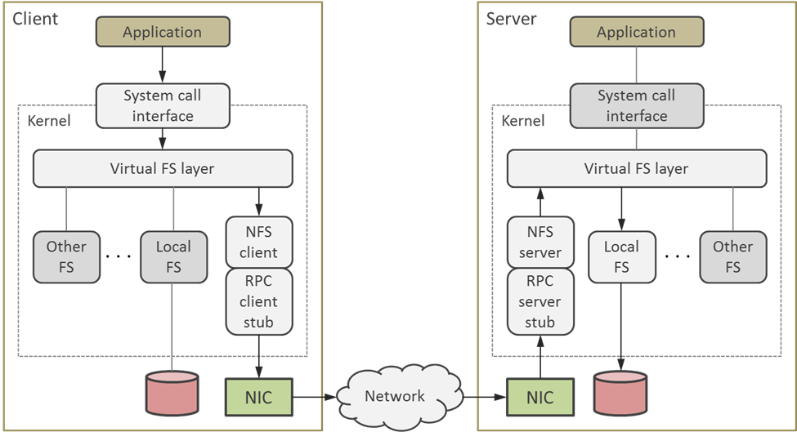
NFS Architecture

Slide 54
Sketch of Access Protocol
Remote file system is mounted on client
Mount program obtains a handle for remote directory from NFS server
Local kernel creates a new vnode for the remote directory in the VFS layer
File open
Parent portion of file’s pathname translates to the vnode
Server address is retrieved from vnode
Lookup request for the remaining path portion is sent to the server
Open file entry is created on client using file handle and attributes supplied by the server (no file open is performed on the remote end)
File descriptor is returned to the (client) application
Data access
Local file cache is checked for data availability (if data caching is enabled)
If that fails, server is asked to provide the data (performs file open and read) for file handle associated with local descriptor
Data arrive at client and are stored in the cache
User buffer is filled as appropriate and call returns
Server maintains replay cache to keep track of non-idempotent requests (e.g., file delete). Matching request with a cache entry causes re-transmission of the recorded reply without re-execution of the request.

Slide 55
NFS Revisions
First public release: NFSv2 (late 1980s)
Outdated (32-bit offsets and file handles, poor write performance due to blocking, small payloads)
NFSv3
64-bit file offsets
Weak cache consistency scheme
Correct support for ACLs from ACL-agnostic clients
Larger data payload per packet
Still in use in some installations
NFSv4 (current)
Servers no longer stateless
File locks respected
Support for lease-based byte-range locking
Caching of file data via delegation mechanism (multiple readers, single writer) with revocation on conflict
Compound RPC (request merging)
Kerberos 5 and SPKM/LIPKEY security
File migration and replication

Slide 56
General Parallel File System (GPFS)
Developed by IBM and released in the late 1990s
Influenced by Tiger Shark file system and Vesta parallel file system (both IBM products)
Renamed in 2015 to IBM Spectrum Scale
Available for AIX (Power architecture), Windows and Linux (x86_64)
Permits multiple clients to access one or multiple file system instances
May span multiple physical devices, including remote storage over SAN or higher level protocols
Supports parallel access to shared files as well as “shared-nothing” operation thanks to File Placement Optimizer
High aggregate access bandwidth is accomplished by striping data across multiple storage devices and load balancing
Supports data replication for recoverability and availability
Multiple GPFS instances (GPFS clusters) may be configured to be visible and accessible from within a single shared namespace
POSIX file access available via VFS integration
Sophisticated token management for concurrent distributed locking
Intelligent prefetching recognizing different access patterns
Journaling for increased data integrity

Slide 57
GPFS Limits
Parameter | Design limit | Tested value
Number of joined nodes per cluster | 16,384 | 9,620
Number of disks per cluster | 2,048 | unknown
File size | 2⁹⁹ bytes | approx. 18 Petabytes
Number of files per file system | 2⁶⁴ | 9,000,000,000

Slide 58
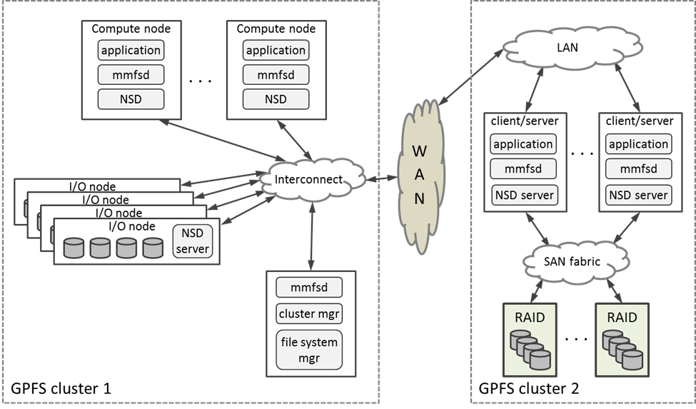
GPFS Architecture

Slide 59
Primary GPFS Components
GPFS daemons (mmfsd)
Implements core functionality
Multithreaded with multiple thread priorities
May directly communicate with each other for improved synchronization
Responsibilities: disk space allocation for new files, directory management, lock operations for data and metadata integrity, buffer management (pagepools), I/O operation scheduling, quota accounting
File system manager
One per file system, possibly distributed
Supervises operation of all nodes using the file system
Responsibilities: configuration services (storage pool expansion and repair, storage availability), storage space allocation, token management (access rights, byte-range locking), quota management
Cluster manager
One per GPFS cluster
Elected by quorum of cluster nodes
Responsibilities: tracking of disk leases, monitoring node health, supervision of recovery processes, selection of file system manager nodes, propagation of configuration changes, mapping of user identities
Network Shared Disks (NSDs)
Provide storage abstraction
Service runs on storage-equipped nodes
Storage components may associate with multiple servers for resilience

Slide 60
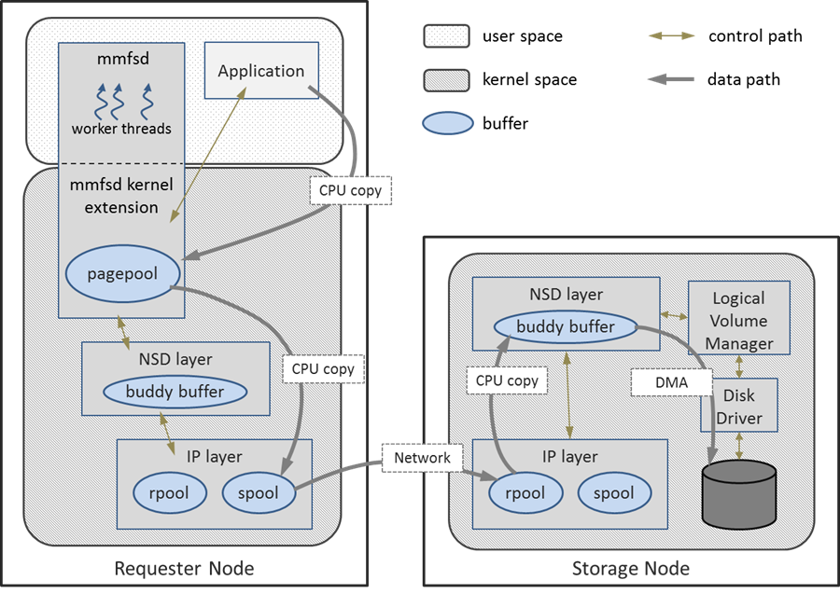
File Write in GPFS

Slide 61
Sketch of Write Algorithm in GPFS (I)
Data write causes:
Flush command invocation
Synchronous write called
Buffers need to be reused
Token is revoked
Last byte of file block was written by sequential access
Scenario 1: Buffer available in client memory and token is valid
Data are copied from application space to available buffer (application may proceed at this point)
mmfsd schedules asynchronous write to storage
Buffer content is broken up into chunks fitting message payloads and copied to send pool
List of destination I/O nodes is derived from metadata
Data are transferred to respective NSD servers’ receive pools
Buddy buffer is allocated to reassemble write buffer contents
Receive buffers are released
Disk write is initiated

Slide 62
Sketch of Write Algorithm in GPFS (II)
Scenario 2: Buffer not available, token is valid
Kernel suspends the calling thread
mmfsd thread attempts to obtain buffer
If entire block is overwritten, a new buffer is used
If not, the remainder of the block is fetched into a buffer
The call proceeds as in Scenario 1, steps 3-8
Scenario 3: No buffer and no token available
Acquire token for required byte range based on I/O pattern taking into consideration conflicts with other accessors
Proceed as in Scenario2

Slide 63
Lustre File System
Name derives from “Linux” and “cluster”
First release in 2003
Developed initially under DOE Accelerated Strategic Computing Initiative (ASCI) Path Forward
Owned at some point in time by Sun Microsystems, Oracle, Whamcloud, and Intel
POSIX-compliant interface, atomic semantic
Highly scalable (tens of thousands clients, PBs of storage, I/O bandwidths in hundreds GB/s)
Dynamic allocation of storage space and bandwidth
Extensive network support with RDMA and bridging
High availability with multiple failover modes and multiple-mount protection
Transparent recovery
Distributed online file system check
POSIX Access Control Lists
Fine-grain locking permitting concurrent operation on shared directories and files
Layout control over whole file system, single directory or a single file
Broad interoperability: specialized MPI-IO ADIO layer, NFS and CIFS exports
Strong presence on the TOP500

Slide 64
Main System Components of Lustre
Management Server (MGS)
Manages configuration information
Capable of sharing devices in MDS pool
Management Target (MGT)
Storage space for MGS (<100MB for most installations)
Requires high reliability devices or device pools
Metadata Server (MDS)
Name and directory content management
Supports distributed namespace (across multiple MDSs)
Provides standby MDSs as a failover option
Metadata Target (MDT)
Stores directories, file names, permissions, layout information, etc.
Distributed operation supported, with one MDT storing the root of the file system or with striped directories across multiple MDTs
Typically uses a dedicated hardware node
Object Storage Server (OSS)
Services data I/O requests
Object Storage Target (OST)
Manages physical storage for file contents
2-8 OSTs typically used per each OSS
Single OST capacity limited to 128TB (256TB on ZFS)
Clients
Execute applications generating the I/O requests
Compute nodes as well as conventional desktops and workstations
Lustre Networking (LNET)
Communication infrastructure
Supports: IB/OFED, GigE, IPoIB, Cray Seastar, Myrinet MX, Raid Array, Quadrics Elan, RDMA
Connectionless and asynchronous

Slide 65
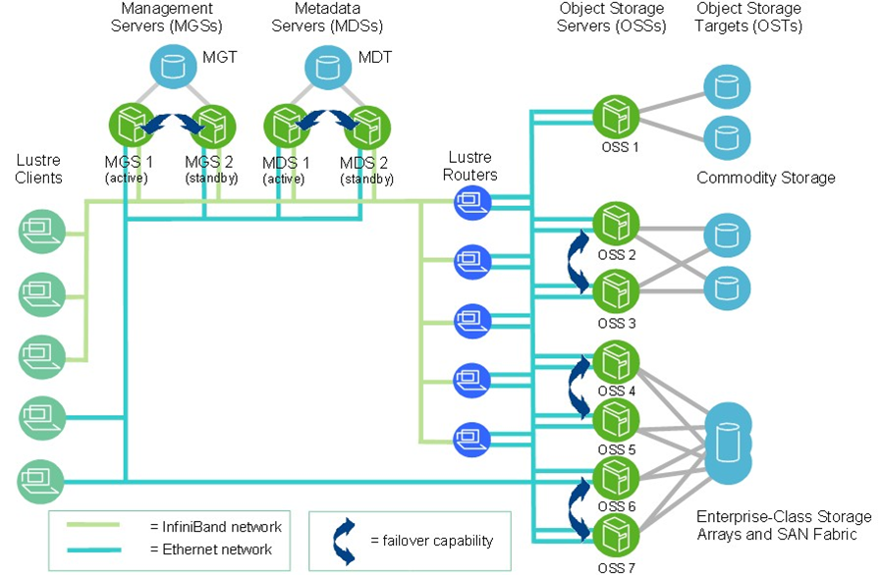
Example Deployment Architecture

Slide 66
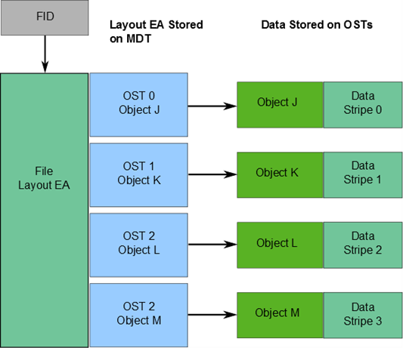
Lustre File Layout
128-bit File Identifiers (FIDs)
64-bit sequence number
32-bit object ID
32-bit version number
Data striped in a round-robin fashion across OSTs
Number of stripes, stripe size, target OSTs are user configurable
Default stripe size: 1MB
Default stripe count: 1
Up to 2000 objects may be defined per file

Slide 67
File Access Locking
Lustre Distributed Lock Manager (LDLM)
Based on locking algorithm used by VAX DLM
Operate in one of six modes:
Exclusive: requested by MDS before a new file is created
Protective Write: issued by OST to client requesting write lock
Protective Read: granted to client(s) that need to read or execute files
Concurrent Write: issued by MDS to clients who request write lock when opening file
Concurrent Read: used during path traversal when performing path lookups and handled by related MDS
Null mode
Types of locks:
Extent Lock: used for OST data protection
Flock: supporting user-space requests for file locking
Inode Bit Lock: for protection of metadat attributes
Plain Lock: limited use

Slide 68
Lustre Lock Management Overview
Callback types:
Blocking callback, invoked when client requests a conflicting lock
Completion callback, issued when a requested lock is granted or is converted to a different mode
Glimpse callback, used to provide information
Each service (OST, MDS, MGS) has its own namespace
Concept of intent is used to enable special processing of lock operation
Each namespace has dedicated intent handlers
Locks are acquired through a sequence of steps:
Check by client locking service if lock belongs to a local namespace. If so, go to (7).
Lock enqueue RPC is sent to the appropriate server. An initial ungranted lock is created.
Inspect if there is an intent set on lock. If not, invoke policy associated with lock function. If yes, proceed to (6).
Check for conflicts with granted and waiting locks. If no, grant lock and invoke completion callback (the lock is acquired). Otherwise, continue.
Invoke blocking callback for every conflicting lock. Enter lock on the waiting list with the “blocked” status.
If lock intent is set, invoke intent handler. Return the result without further interpretation.
Local locks are created and equeued to check if they can be granted. If they can be granted or error is detected, return the appropriate status. Otherwise, the lock request is blocked.
Locks in Lustre are normally held indefinitely. Their release is initiated when
A conflicting request is received
A blocking callback is issued by LDLM or
A blocking callback is invoked on the client node

Slide 69
Lustre Design Limits
Parameter | Design target | Production tested
Maximum file size | 31.25 PB (ldiskfs) 16 TB (32-bit ldiskfs) 8 EB (ZFS) | Multiple TB
Maximum file count | 32 billion (ldiskfs) 256 trillion (ZFS) | 2 billion
Maximum storage space | 512 PB (ldiskfs) 1 EB (ZFS) | 55 PB
Number of clients | ≤131072 | 50000+
Single client I/O performance | 90% network bandwidth | 2 GB/s data I/O 1000 metadata ops/s
Aggregate client I/O performance | 10 TB/s | 2.5 TB/s
OSS count | 1000 OSSs, up to 4000 OSTs | 450 OSSs with 1000 4TB OSTs 192 OSSs with 1344 8TB OSTs 768 OSSs with 768 72TB OSTs
Single OSS performance | 10 GB/s | 6+ GB/s
Aggregate OSS performance | 10 TB/s | 2.5 TB/s
MDS count | ≤256 MDTs, ≤256 MDSs | 1 primary and 1 backup
MDS performance | 50000 create ops/s 200000 stat ops/s | 15000 create ops/s 50000 stat ops/s

